Slide 1
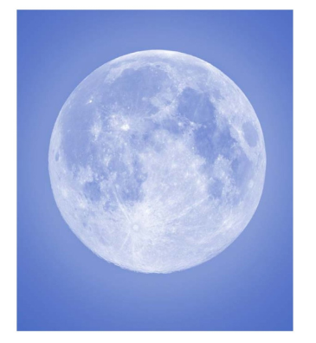
Shapes In Nature

Slide 2
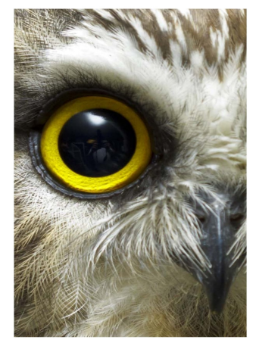
I see a circle shape.

Slide 3
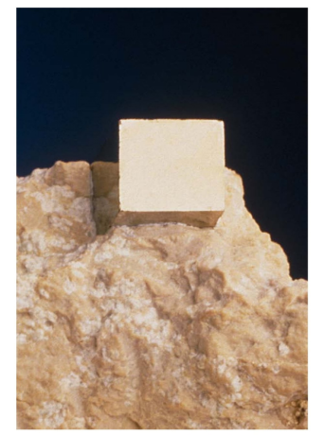
I see a square shape.

Slide 4
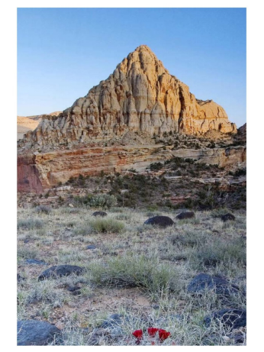
I see a triangle shape.

Slide 5
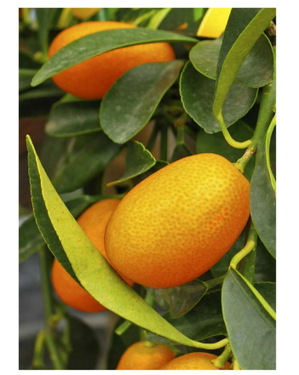
I see an oval shape.

Slide 6
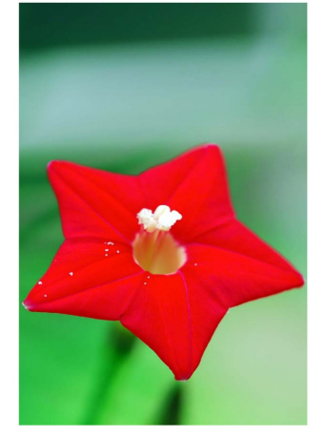
I see a star shape.

Slide 7
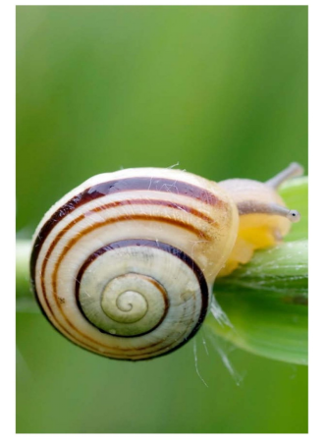
I see a spiral shape.

Slide 8
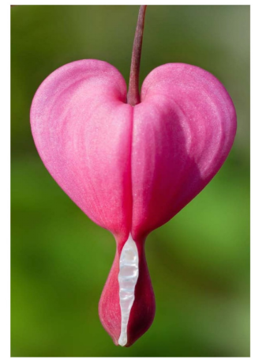
I see a heart shape.

Slide 9
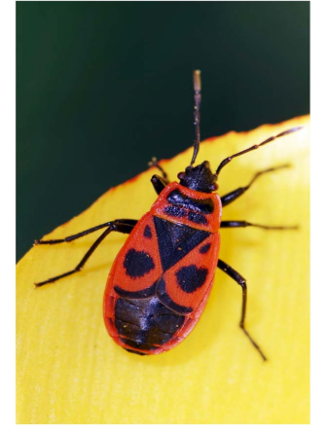
I see shapes.

Slide 10
Circle
Square
Triangle
Click on the colored stars to start getting to know them!
Oval
Star
Spiral
Heart
Shapes

Slide 11
RETURN
I see a circle shape.

Slide 12
RETURN
I see a square shape.

Slide 13
RETURN
I see a triangle shape.

Slide 14
RETURN
I see an oval shape.

Slide 15
RETURN
I see a star shape.

Slide 16
RETURN
I see a spiral shape.

Slide 17
RETURN
I see a heart shape.

Slide 18
RETURN
I see shapes.

